Slide 1
Project OS Build
Setting up Test Environment
Installing Virtual Machine software.
Setting up Virtual Machine.
Install QEMU.
Assemble and Test Bootloader.

Slide 2
Purpose of Assignment
The overall class goal is to examine a practical Operating System from boot to operating a command line interface.
The assignment goal is to set up the environment for emulating a 386 processor-based computer and learning the bootloader process, examining and executing a very simple assembly language boot loader.

Slide 3
Interface Note
This assignment will ask for a screenshot (or image) and a modified copy of print.asm, review the assignment slides carefully.
QEMU will be a virtual machine within a virtual machine, both machines can sometimes capture the mouse to release the mouse the default key should be Ctrl-Alt for QEMU and the right CTRL key for Oracle VM (though I have mouse capture turned off for my Oracle VM settings). When you run QEMU you can set a flag to turn off mouse capture, see qemu-system-i386 –help for options (there are so very many of them so be aware).

Slide 4
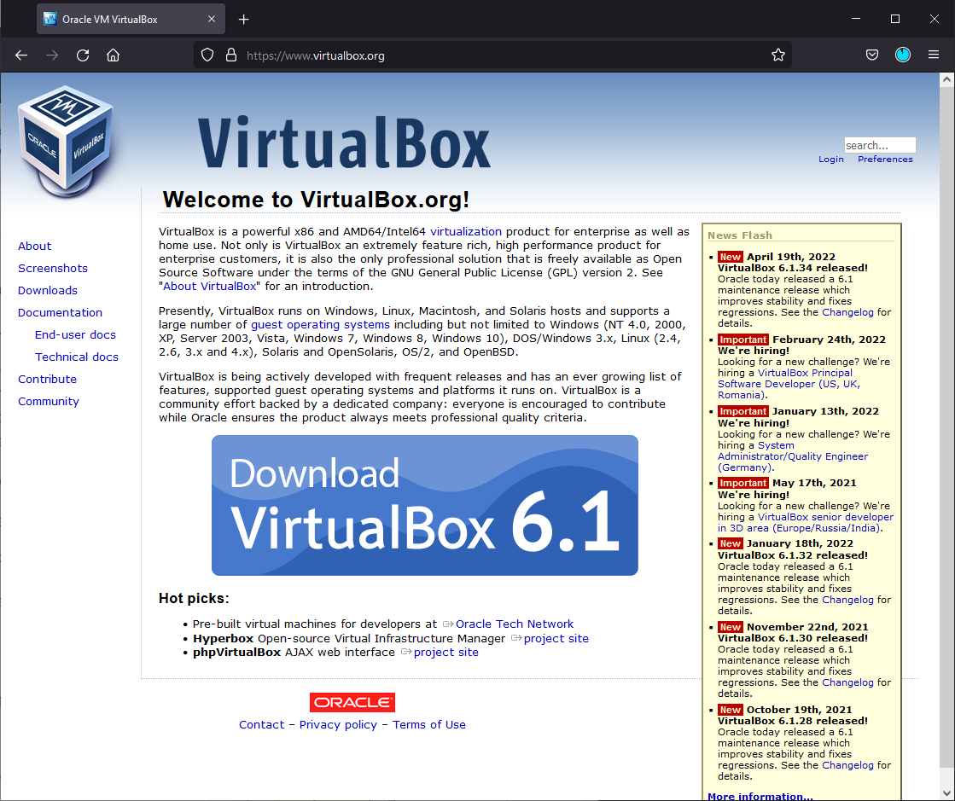
Oracle VM
https://www.virtualbox.org/
Download the current version ,v6.1 as of this writing, appropriate for your host hardware and OS.
A new version 7.1 does exist and will work just as well, but the screens for VM setup are different.
Be sure to set hard-drive size to FIXED!
Be sure DISABLE the Unattended INSTALL!

Slide 5
MAC (with INTEL/ARM cpu) alternative
For MACintosh you can use UTM instead of ORACLE VM. It is written for the MAC OS and tends to be smoother. Just keep the same settings as below Remember to use a FIXED HARDDRIVE size!
It can be obtained at: https://mac.getutm.app/
They have completed update for it to emulate Intel Silicon on ARM chips so this should work for everyone now including ARM based MACBOOK Air but I’ll need a volunteer to help me go through this with them.

Slide 6
System Requirements
Absolute minimum, it likely will not run if you have below this configuration and not too well with it:
  2 CPU Cores (Give 1 to VM and 1 to Host, expect to see lag and outright halts for long periods)
  8Gb RAM ( U16 will not run will less than 4Gb, though light weight installations like Arch and Tiny etc. can run on as low as 1Gb or less)
  12Gb Free Hard drive space (U16 will usually take up 4-6Gb upon install + room for the updates and QEMU etc.)
General lowest recommended:
  4 CPU Cores (Give 2 to VM still expect to see some lagging)
  8 Gb RAM ( Give 4Gb to VM but this may make host slow as well)
  16Gb Free Hard drive space

Slide 7
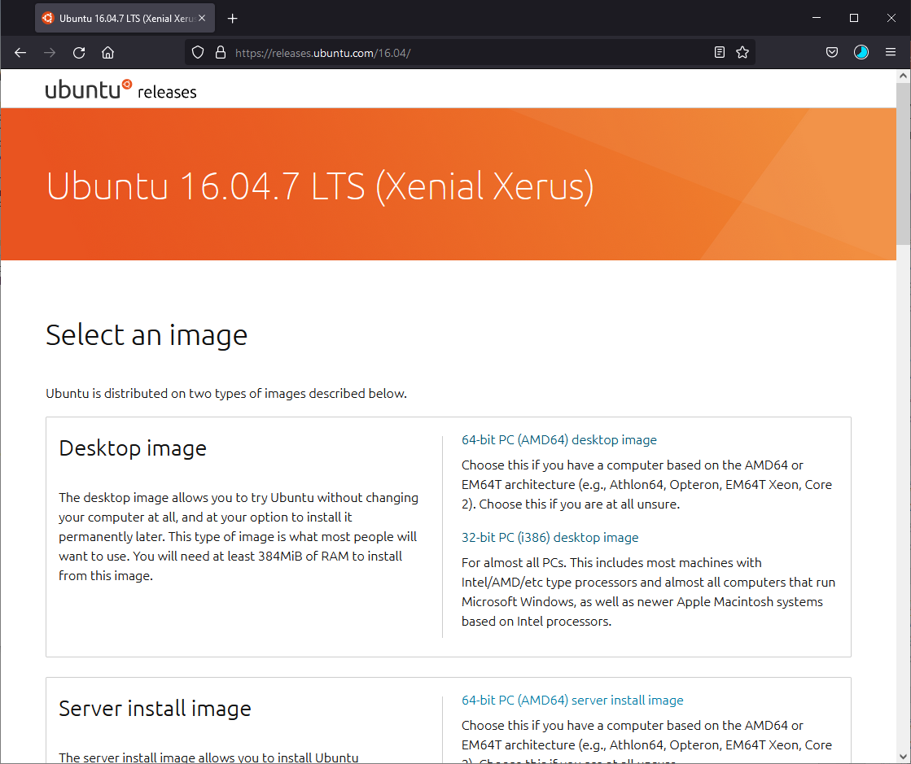
Linux host operating system iso image.
https://releases.ubuntu.com/16.04/
Running QEMU under windows does work but is somewhat difficult to setup so it is preferred to use a Linux environment.
Get the appropriate desktop image for your host hardware and OS.
e.g., the 64-bit PC(AMD64) desktop image
You can use other OS distributions like Centos, Arch, KDE, FreeBSD so long as you can install on VM and run QEMU on them.

Slide 8

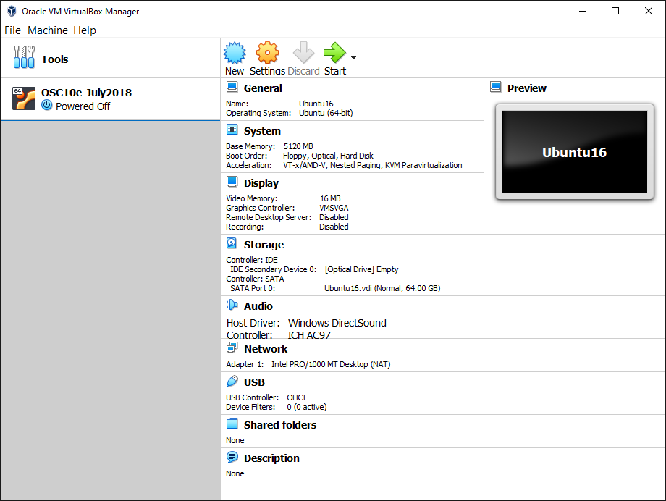
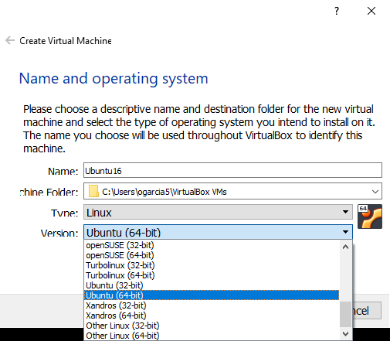
Set up VM Host
Create a new VM to match iso image.

Slide 9
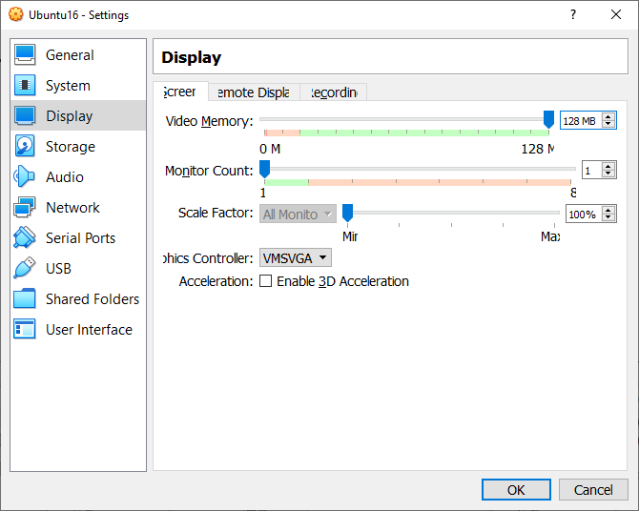

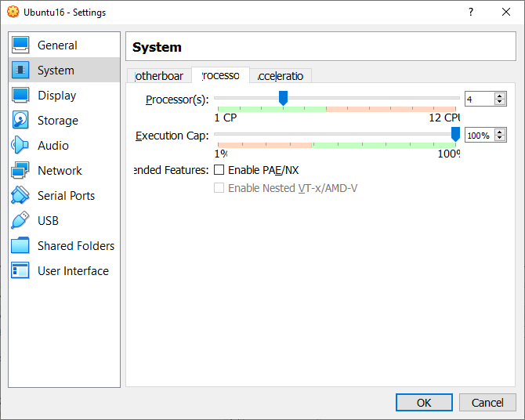
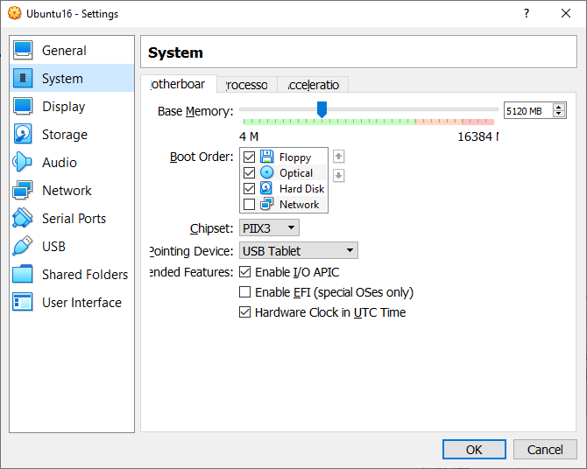
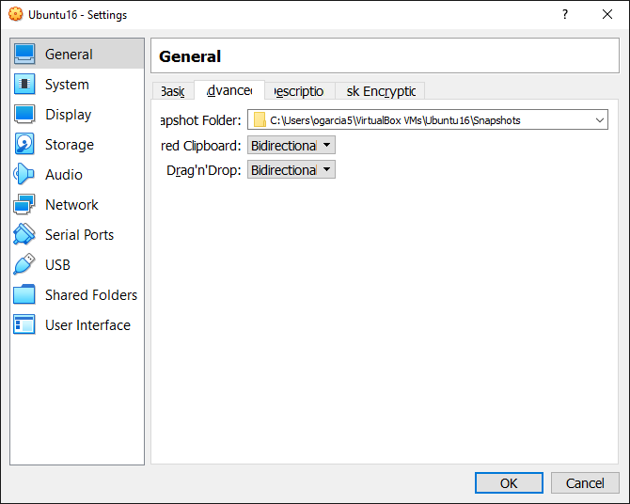
Set up VM Host
Set Video memory to max and
If GPU check 3D Acceleration
Configure Settings for VM
Ubuntu is pretty heavy on resources, e.g. Arch requires 1-2Gb RAM and much less
Virtual hard drive space. Goal here, though, is uniformity to make sure it runs
for everyone the same.
Share text and objects
Between host and VM
At least 2 cores
At least 4096 Mb

Slide 10
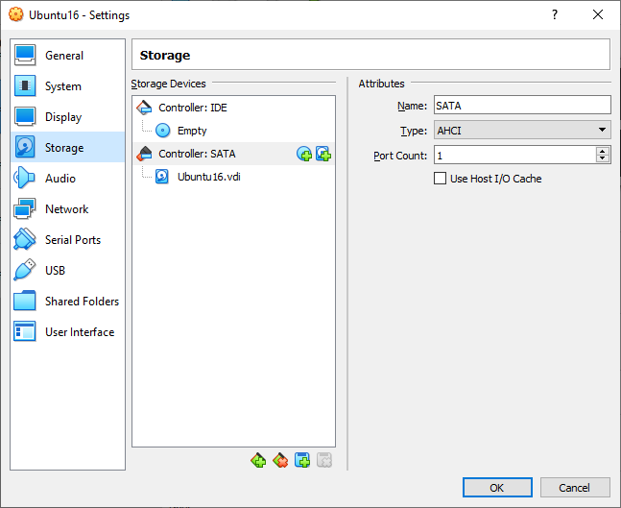
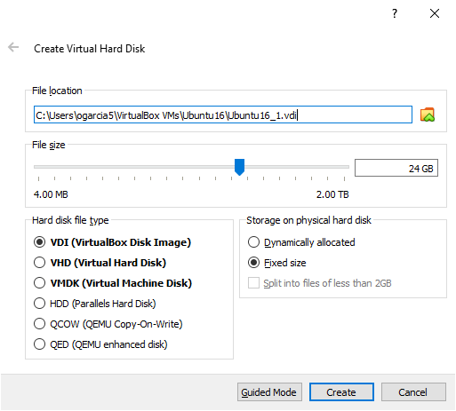
Add and configure the VM Hard Drive
In Settings->Storage select add new hard disk.
Set the size and be sure to make it “Fixed size” or weird problems result.

Slide 11
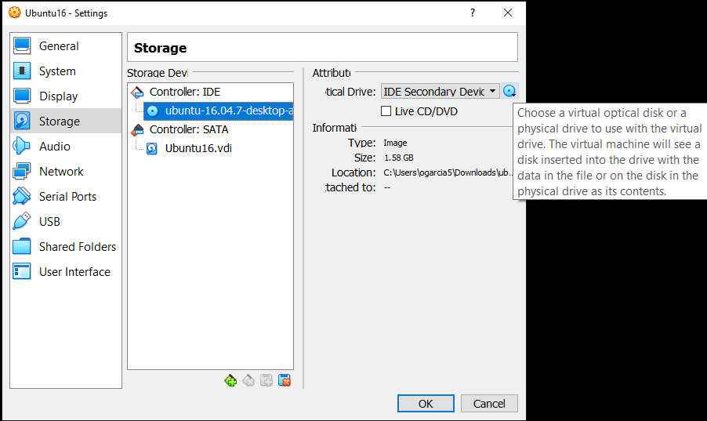
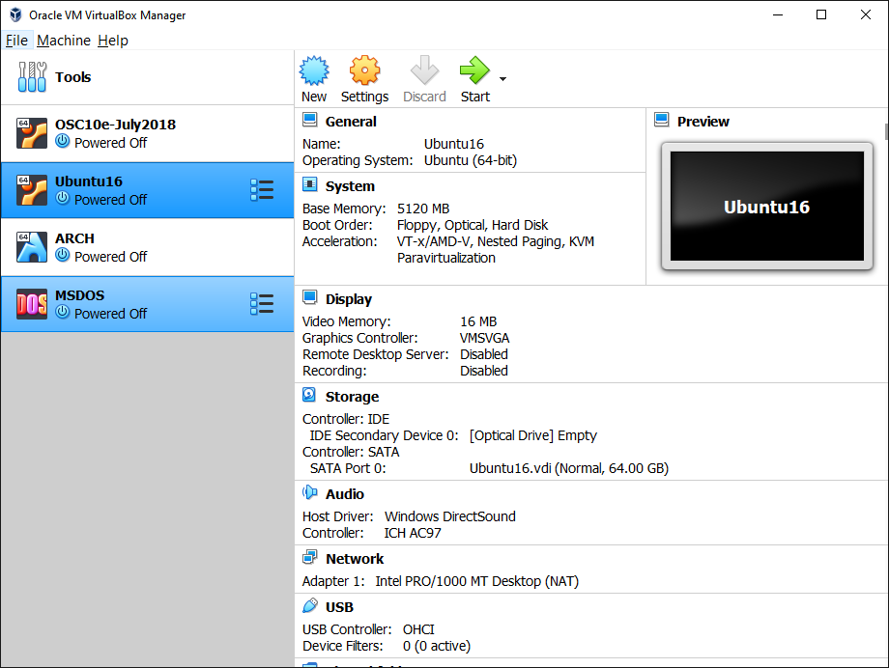
Set up VM Host – CD ROM Image
Place ISO image into VM DVD drive
Double click VM to start.
Select the .iso image you chose and stored
here as an optical source.

Slide 12
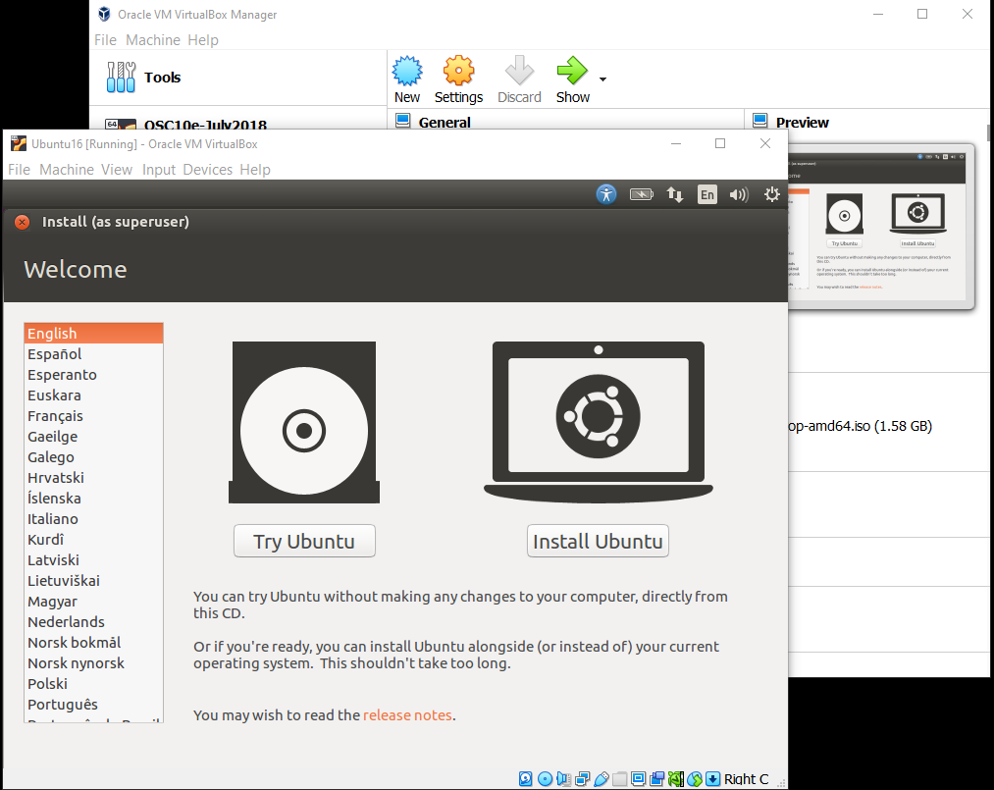
Install VM OS
Ubuntu (even old v16) is a rather heavy and laden distribution.
Alternatively you can install ARCH linux (which has QEMU 7.0 natively installed already) or any of the other light weight distributions so long as QEMU works with them (may need to install gtk and compiler toolsets in addition to nasm)

Slide 13
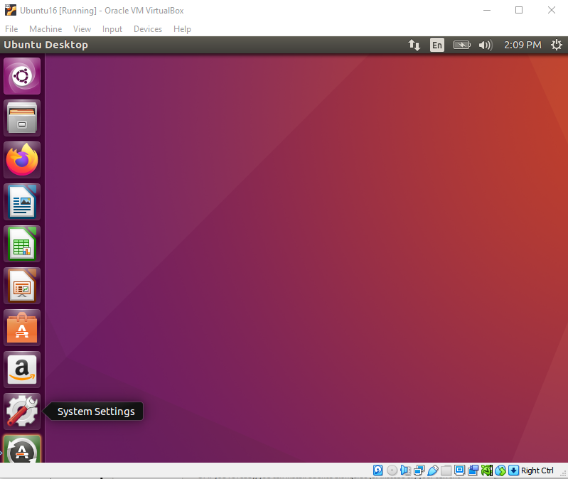
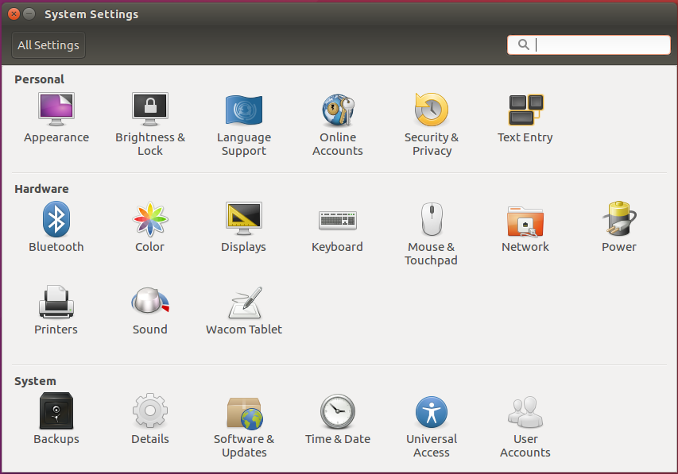
Install VM OS
Select System Settings / Displays to change display
Resolution to something less cramped.

Slide 14
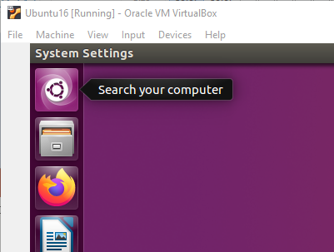
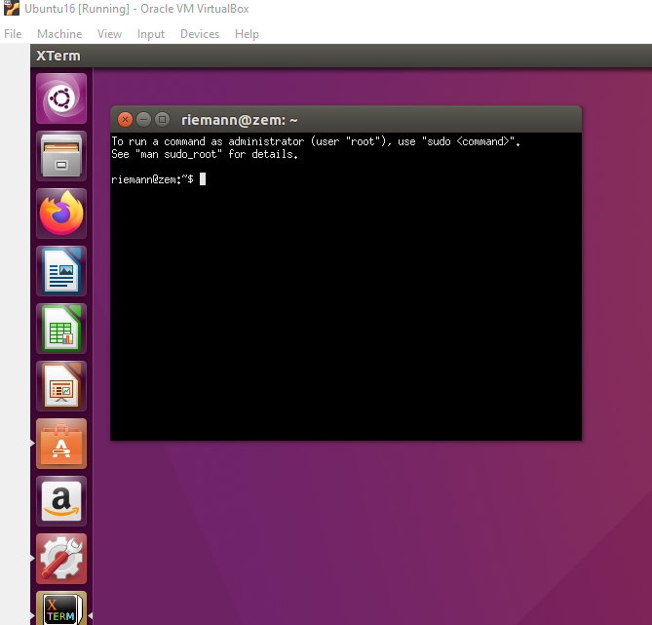
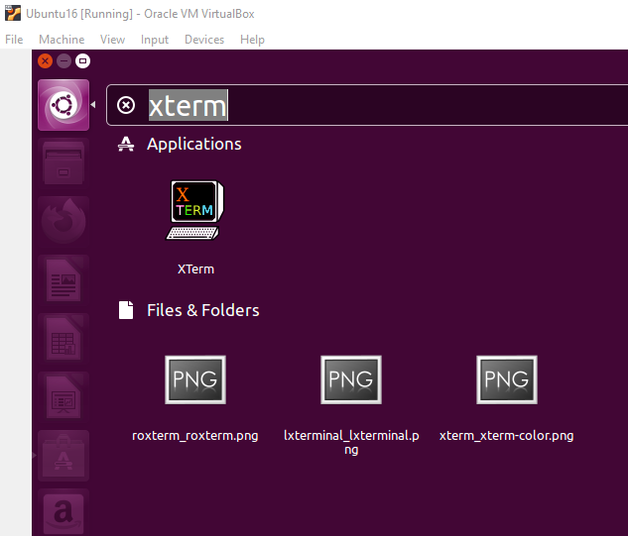
Setting up QEMU
Run XTerm

Slide 15
X-Term
X-term is a command line interface CLI and it runs the shell program bash – bourne again shell an extension of bsh an improvement to the original unix shell sh.
CLIs will have a library of commands for interfacing with the OS. These are what you type in the prompt to complete tasks.
For our purposes the common commands used here will be:
cp – Copy a file or directory
mv – move a file or directory
rm – Remove a file or directory
ls – list a directory and file properties
cd – change (to a) directory
pwd – show where you are: Print working directory

Slide 16
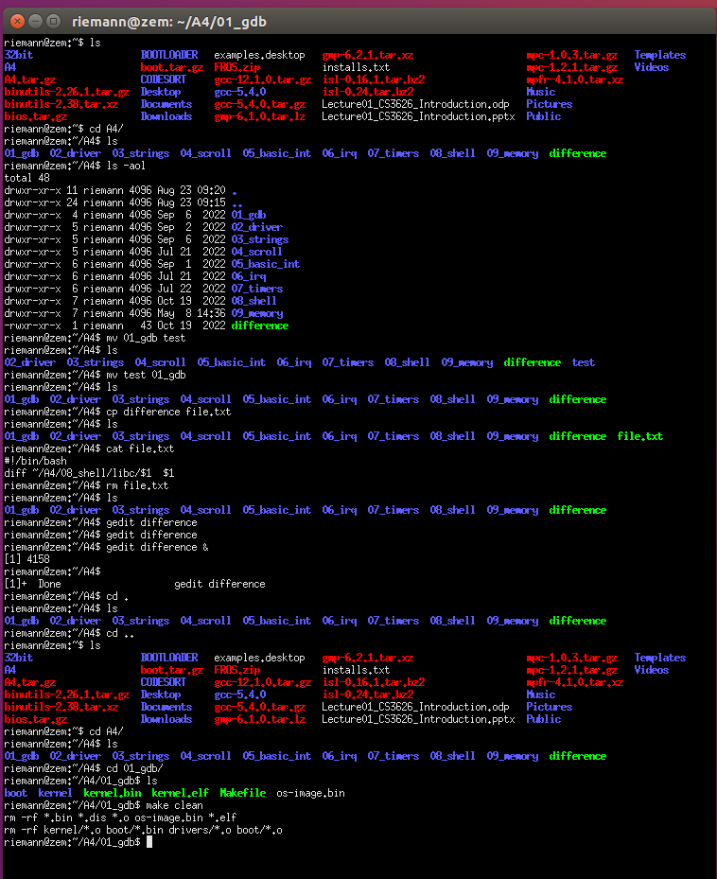
Commands for the CLI
ls show the files in current directory
ls –aol show more file details
mv <source> <destination> move a file from source to dest
cp <source> <destination> copy a file (will overwrite dest)
cat <file> output contents to terminal
gedit <file> & bring up a generic text editor
& argument means place in background
cd <directory> change to a directory
cd . change to current directory (NOP)
cd .. Change to parent directory
cd ~ change to your home directory
make build a project defined by Makefile
~ is a shortcut for the home directory path /home/Riemann (sometimes /usr/home/username or /var/home/username on different configurations)
Bash and the GUI are case sensitive and CD is different than cd, Cd and cD
Your current directory is indicated by your shell prompt (the $):
e.g. riemann@zem:~/A4/01_gdb$ can be read as username@hostname:<current directory>$

Slide 17
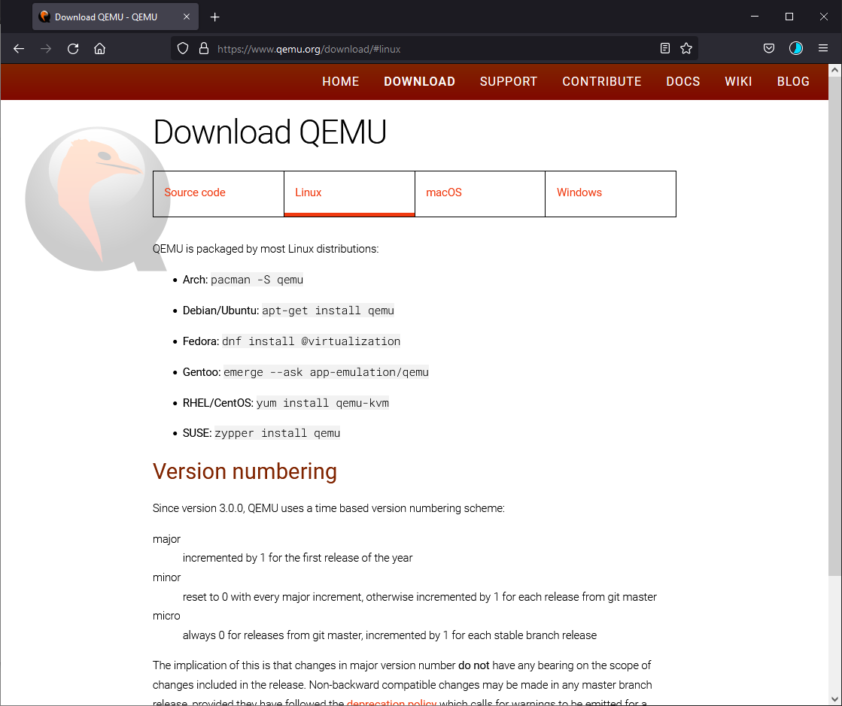
QEMU
Install QEMU in virtual machine.
This page is telling you the CLI command to use:
I.e. for us (Ubuntu 16) it is:
sudo apt-get install qemu
See next page first.

Slide 18
Setting up QEMU
In Xterm CLI run the following commands:
sudo apt-get update
(the first time it will prompt for your password, you should be default in sudo group; just enter your password again)
sudo apt-get upgrade
sudo apt-get dist-upgrade
sudo apt-get install nasm
sudo apt-get install qemu
sudo is short for “super-user do”

Slide 19
The bootloader
This is a basic bootloader for a BIOS based system:
  ; A simple boot sector program that loops forever
  loop:
  jmp loop
  ; the line below fills in remainder with zeros up to 510 bytes
  times 510-($-$$) db 0
  ; 386 CPUs required this number at end to recognize as bootsector
  dw 0xaa55
  ; Total Size is 512 bytes with only two bytes for our bootloader code eb -2
basic.asm
The hexdump of this loader looks like this (image right):

Slide 20
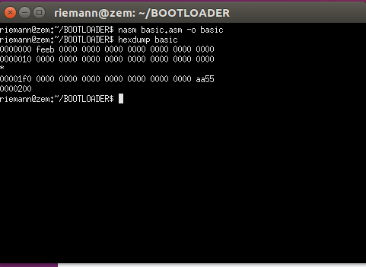
Testing Bootloader
Earlier you installed NASM using
sudo apt-get install nasm
From your x-term CLI change directory to where basic.asm is located. (BOOTLOADER in the case shown on the right). Then run the commands:
nasm basic.asm –o basic
hexdump basic
It should show something similar to the right here.

Slide 21
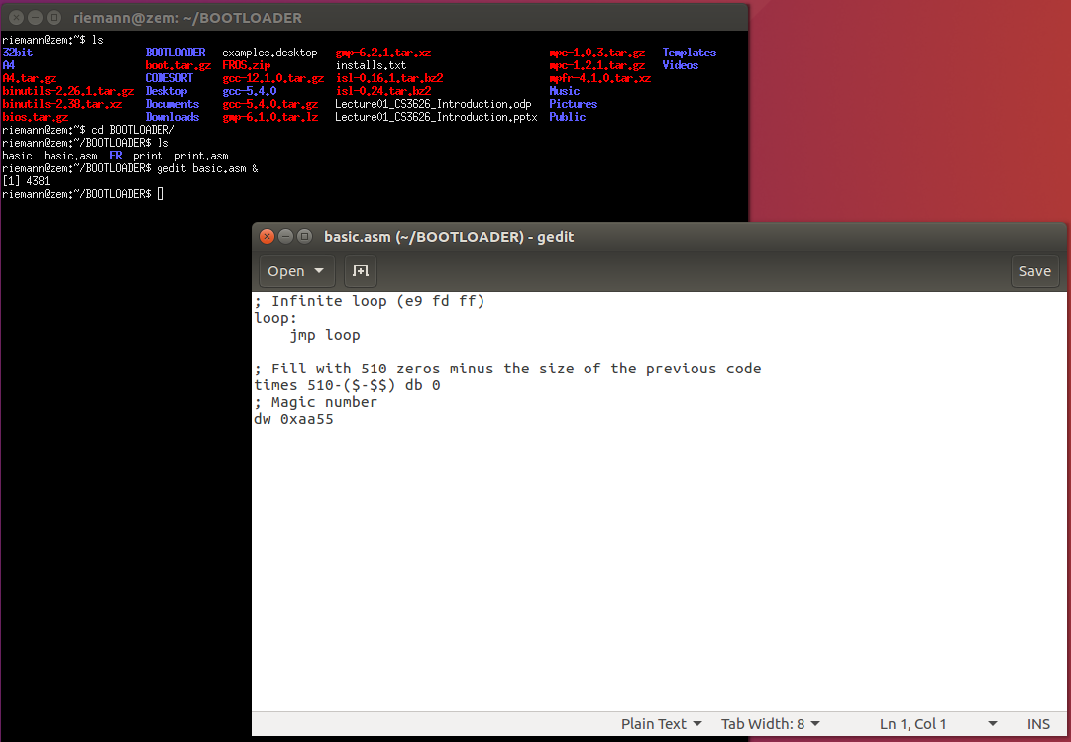
Using gedit to edit files
From the CLI go to where basic.asm using cd (change directory):
I placed mine in BOOTLOADER
cd BOOTLOADER
gedit basic.asm &
This will bring up a notepad like editor. You can also use an IDE like IntelliJ or similar as well if you install it.

Slide 22
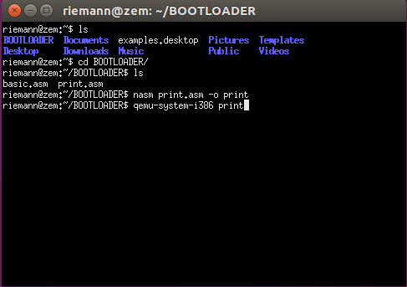
Testing a boot loader
Once the environment is set up download the print.asm file from D2L and save it in your home directory in the environment.
You can run Firefox from the VM (should be version 88 which is old but still works with KSU D2L as of 01/08/2023) to retrieve print.asm or you can type in the code using an editor and storing it as an .asm file. “gedit” and “vim” are to native text editors:
gedit print.asm & (the & puts it in background) from the Xterm CLI will bring up an editor window much like “notepad” for windows.
In Xterm cd (change directory) to print.asm is stored and assemble it with
    nasm print.asm –o print
Then use QEMU to load the bootloader binary “print”
    qemu-system-i386 print

Slide 23
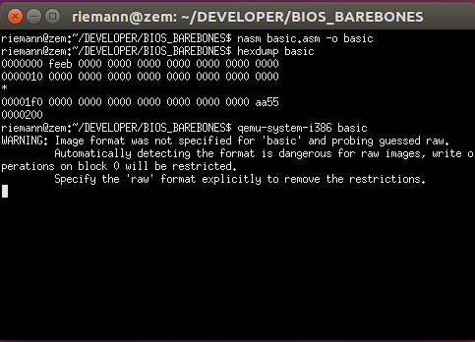
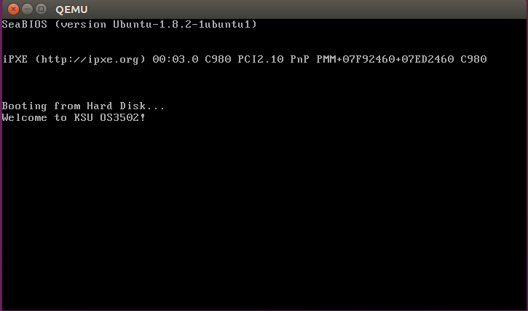
Running the Bootloader
Success!
If you see a new window like this, bootloader was successful.

Slide 24
Alternatives
In MAC you may be able to use brew (or other manger) to install the environment applications directly into the OS without a using a VM.
  You will need a way to figure out how to install/use gcc 5.4 from a MAC command shell.
  You will need to make sure QEMU and NASM work.
Similarly for Windows, You can get Ubuntu 16 from the Windows Store and it will install 16.04 as a local shell, though you may run into some problems.
  You’ll need to set up WSL (1 or 2). You may need to enable mode VM2 in the BIOS.
  QEMU will not run except in curses mode unless you do the difficult but not impossible task of setting up an X-Windows host on windows.

Slide 25
Modify the bootloader
Edit print.asm to change the message to something else. This means changing the ‘W’, ‘e’, ‘l’… etc. characters one at a time before int 10h instruction.
Assemble (with nasm) the modified print.asm file.
Submit a screenshot with the modified result and the modified print.asm text in your Word HW submission document for parts I and II.
NOTE: A QEMU virtual machine is running within the ORACLE VM-WARE virtual machine. There are two mouse captures that could take effect.
  If you click inside the QEMU screen it will trap the mouse. To release press CTRL-ALT (it may be different host keys but will be described in the lower right corner of the VM window).
  If your mouse it captured by the VM press the right CTRL key (the host key) to release it.
  To take a screenshot you may have to click outside the Virtual-Machine and hit Print-Screen or whatever application you use or take a photo. Open the save image in an editor and crop the relevant parts out. Don’t submit the entire screen just the relevant parts.

Slide 26
Coding Requirements
In addition to the implementation of the kernel routines themselves they will need generic data structure code to implement.
You will need to do implementations in C with no additional libraries beyond the basic Gnu C libraries (i.e. no C++ libraries). This is due to the kernel needing to be as small and efficient as possible until you can get your own compiler set up.

Slide 27
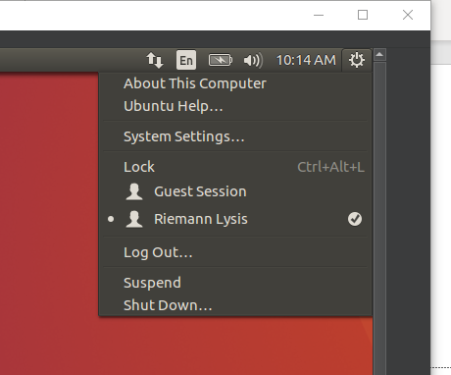
Powering off the VM
One last word…
The VM is a computer with file locks just like any other system.
Best way to shutdown your VM to avoid corrupting files is to click the sprocket on the top right hand and select shutdown.

